Slide 1
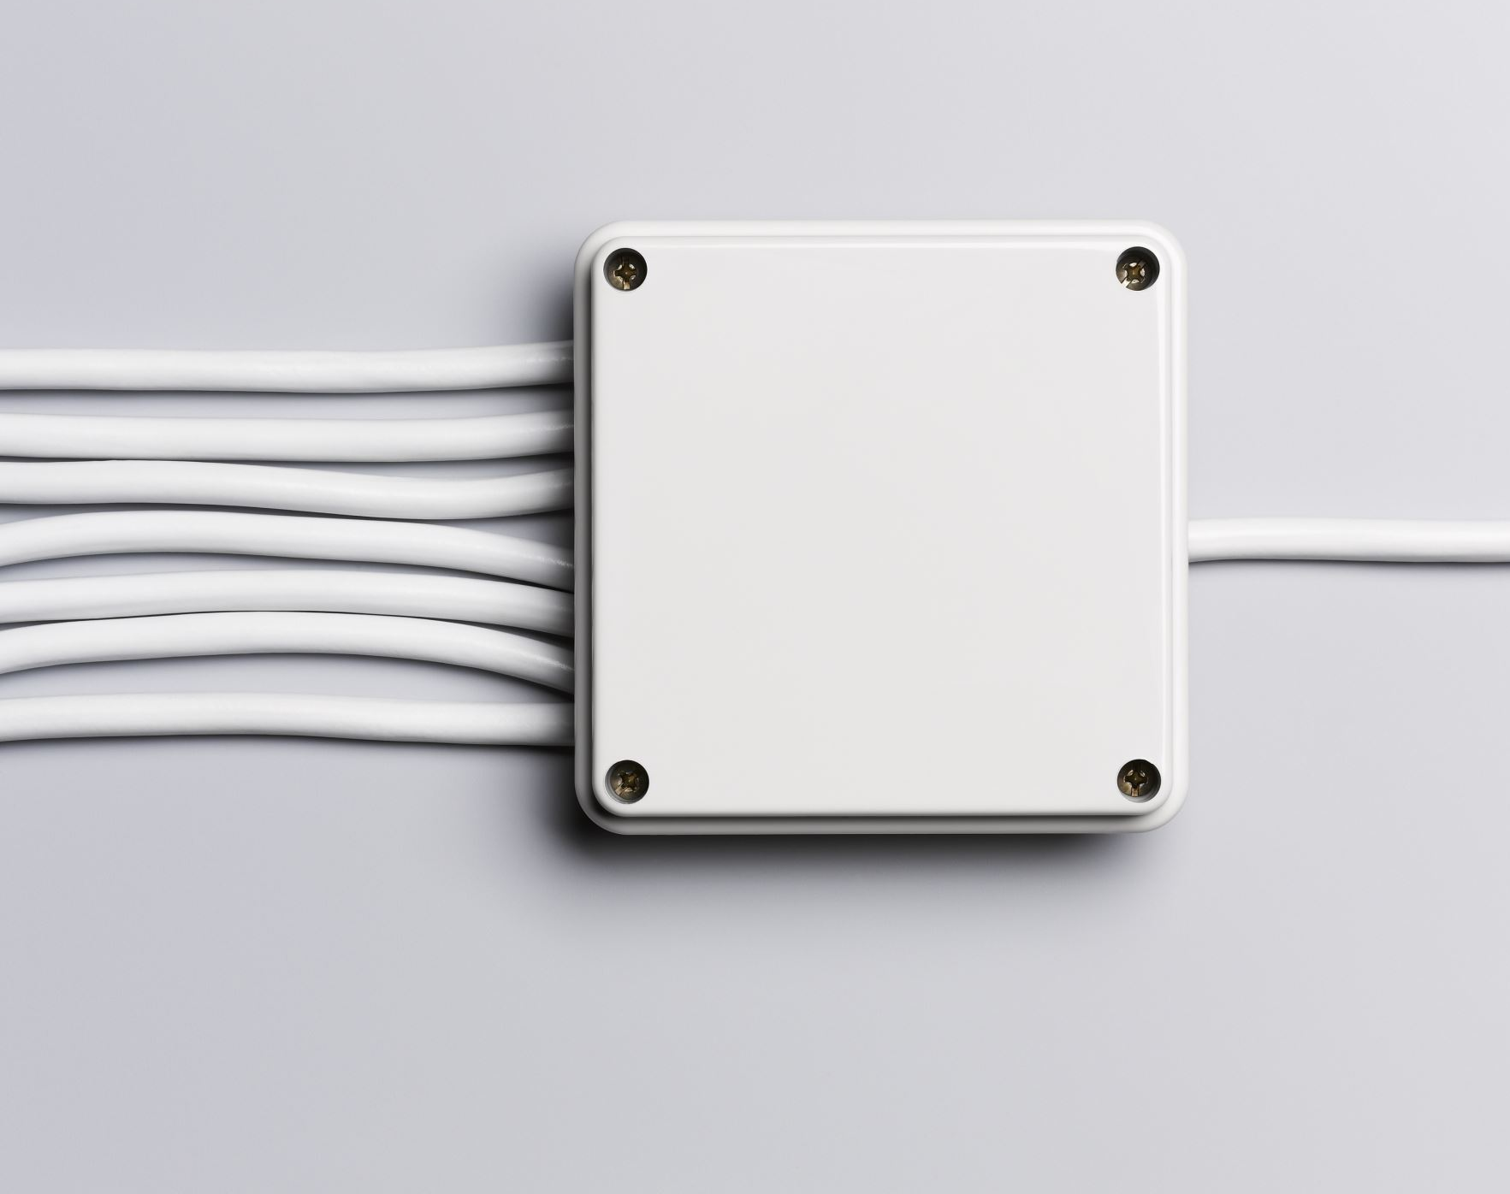
CUSTOMIZATION OF LIGHTING AND VENTILATION SYSTEM IN HOUSEHOLD
Final Year Project – Batch 2019-23
Team Members:
Iswarya M – 19BCS043
Anju A – 19BCS109
Prasanth P – 19BCS117
Faculty Guide:
Dr. K. R. Baskaran
Professor
Department of Computer Science and Engineering

Slide 2
CONTENTS
Problem statement
Objective
Scope
Modules
Flow diagram
Face recognition
Data collection
Machine learning Algorithms
Working model
Concerns

Slide 3
PROBLEM STATEMENT
Smart homes are still based on explicit input from apps or telling Alexa to do something. At home you don’t always carry your phone. Ideally we want homes to be more reactive to what we do, to adapt to us. Developing automated systems that track occupants and self adapt to their preferences is a major next step for the future of smart homes.

Slide 4
OBJECTIVE
Developing a lighting and ventilation system which works automatically according to the user preference data which are collected from the usage of fan and light by the particular user.

Slide 5
SCOPE
The use of data(speed of fan, light intensity) collected from user preferences and machine learning to create an automated model of fan and light system provides great comfort for elderly people.
People don’t have to carry the remote or phones to regulate the appliance as in remote controlled or app controlled versions.
In this project, the appliance work according to the particular user once it recognizes them using a camera. If the camera captures an unknown user, a mail will be sent to a known user regarding this and works according to the environment.

Slide 6

LITERATURE SURVEY

Slide 7
Comparison of Literatures
Paper Title | Year | Methodology | Devices Used | Main Contributions
Low-cost automation system for smart houses based on PIC microcontrollers | 2020 | Experimental | PIC microcontrollers, relays, Wi-Fi module, Android app | Developed a low-cost automation system for smart houses using PIC microcontrollers. The system allows users to control home appliances remotely and receive real-time status updates.
IoT based smart street light management system | 2017 | Experimental | Sensors, microcontroller, Wi-Fi module | Developed an IoT based system for managing smart street lights that is efficient, reliable, and cost-effective. The system uses sensors to detect vehicle movement and adjust the brightness of the street lights accordingly.
Smart home automation using machine learning algorithms | 2020 | Experimental | Raspberry Pi, sensors, machine learning algorithms | Designed a smart home automation system that utilizes machine learning algorithms for personalized services. The system learns user behavior and adapts to their preferences, automatically adjusting home appliances to optimize energy consumption and improve comfort.

Slide 8
Paper Title | Year | Methodology | Devices Used | Main Contributions
Automatic fan speed control using temperature and fan speed control using Arduino | 2018 | Experimental | Arduino microcontroller, temperature sensor, motor driver | Developed an automatic fan speed control system based on temperature using an Arduino microcontroller. The system is cost-effective and energy-efficient, automatically adjusting the speed of the fan based on the room temperature.
Speed control of ceiling fan using PWM technique | 2017 | Experimental | Microcontroller, MOSFETs, capacitors | Developed a system for speed control of ceiling fans using Pulse Width Modulation (PWM) technique. The system provides a cost-effective and energy-efficient way to control the speed of ceiling fans, reducing energy consumption and increasing comfort.
An IoT smart lighting system for university classrooms | 2020 | Experimental | Raspberry Pi, sensors, Wi-Fi module | Developed an IoT based smart lighting system for university classrooms to optimize energy consumption and improve the learning environment. The system uses sensors to detect occupancy and adjusts the lighting accordingly, providing an energy-efficient and comfortable learning environment.

Slide 9
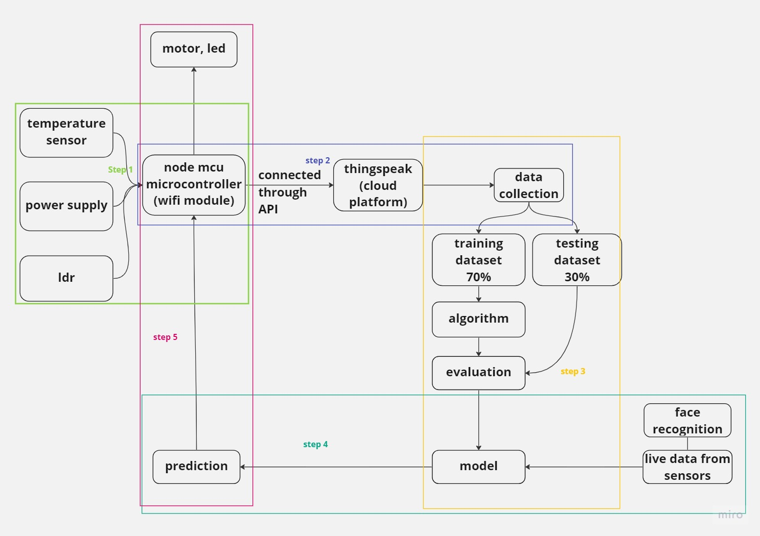
FLOW
DIAGRAM

Slide 10
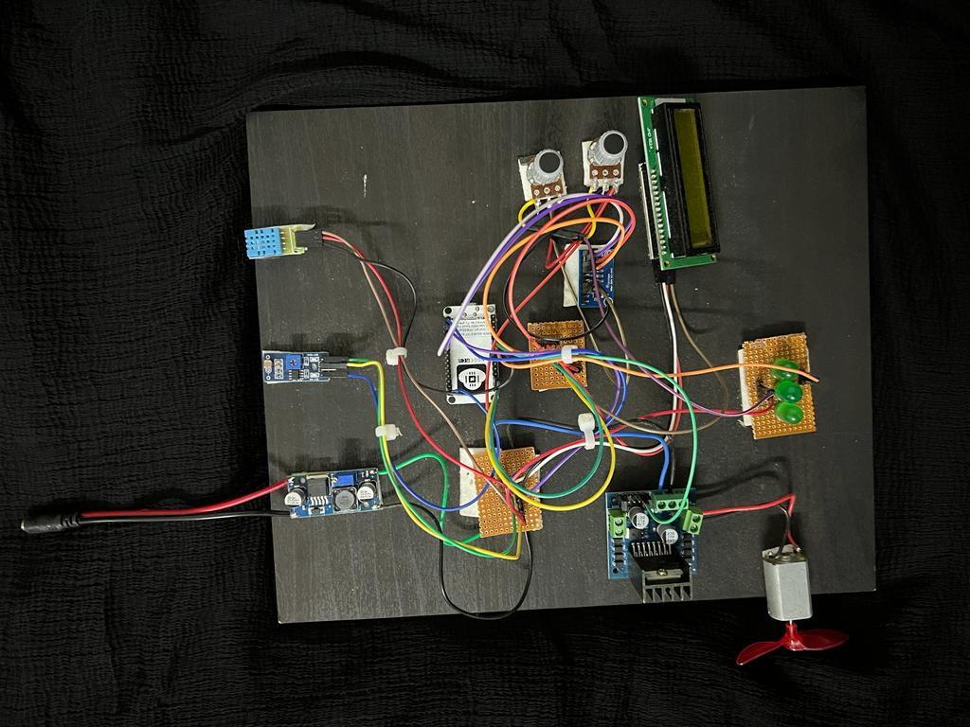
PHASE 1
Development of hardware model to collect the light intensity and fan speed data.

Slide 11

PHASE 2
Development of an automated lighting and ventilation system which works according to the preferences of the user.

Slide 12

FACE RECOGNITION
There are two known users , whose face will be recognized by the camera and the working of the prototype would be according the particular user.
Libraries installed : opencv, face_recognition

Slide 13
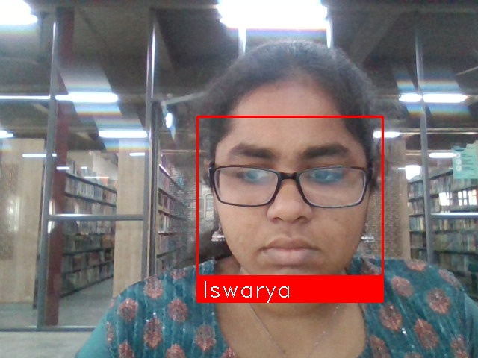
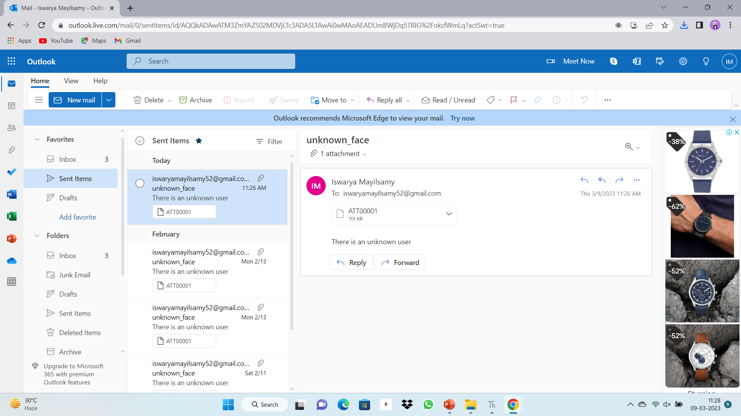
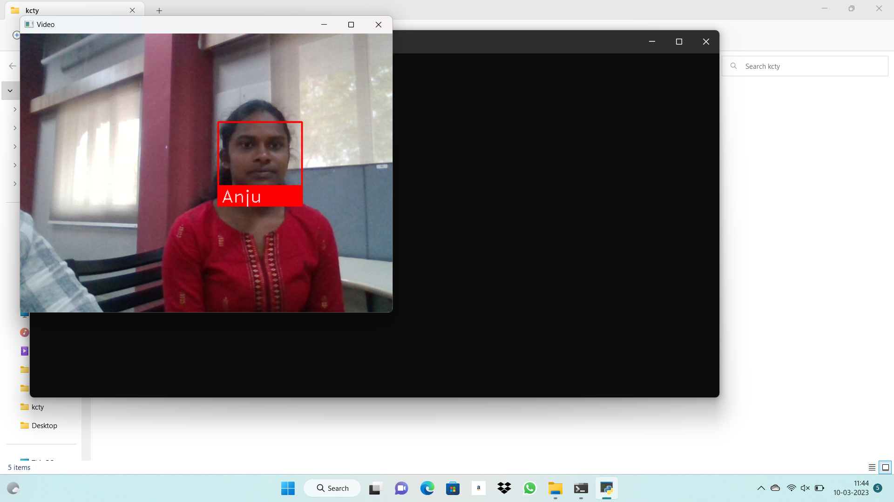
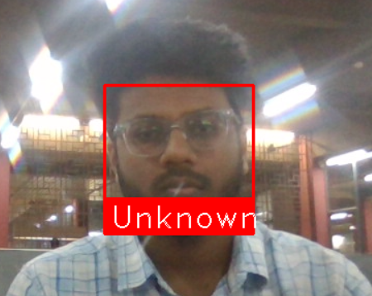

Slide 14

DATA COLLECTION

Slide 15
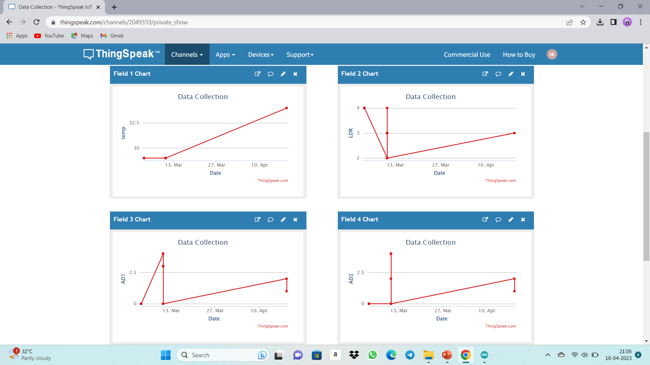

Slide 16
DATA COLLECTED
Date
Time
DHT value
LDR value
Fan speed
Light intensity

Slide 17
PROCESS OF DATA COLLECTION
Cloud : THINGSPEAK
ESP8266 wifi module is connected to ThingSpeak platform from where we could collect the data such as time, date, LDR value, DHT value, fan speed and light intensity.

Slide 18
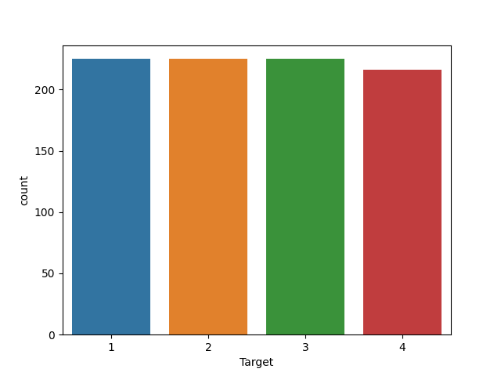
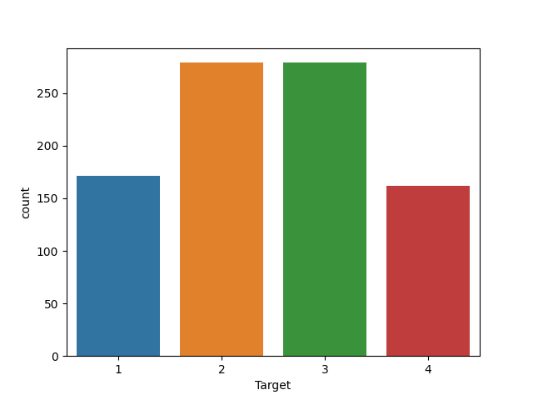
TARGET - COUNT
FAN SPEED
LIGHT INTENSITY

Slide 19
MACHINE LEARNING ALGORITHMS
SVM
Fan : 89.66
Light : 92.07
Naïve Bayes
Accuracy Score
Fan : 87.59
Light : 92.07
KNN
Accuracy Score
Fan : 93.45
Light : 92.07
Random Forest
Accuracy Score
Fan : 91.38
Light : 90.69
Decision Tree
Accuracy Score
Fan : 91.38
Light : 89.66
Accuracy Score
From the comparison of the above mentioned algorithms, it is concluded that, for the data collected for this project, K-NN suits the most and gives higher accuracy than others.

Slide 20
WORKING MODEL
The model works according to the user preference data which are collected from the hardware model.
The data collected is trained using various machine learning models.
One model out of those is selected to send the trained model to the microcontroller which in turn controls the fan and light.

Slide 21
FUTURE ENHANCEMENTS
Collection of data from smart band like devices for use of elderly persons in health sector.
Addition of RTC (Real Time Clock) for considering date and time in this working of personlaization.

Slide 22

THANK YOU

